Slide 1
CSS on Source Forge
Kay Kasemir, Xihui Chen (SNS)
Gabriele Carcassi, Kunal Shroff (BNL)
John Hammonds (APS)
Matthias Clausen, Helge Rickens (DESY)
and growing
June 2010

Slide 2





CSS is a Collaboration
Started at DESY
SNS joined early
Recently
  BNL evaluated BOY, building SNS-type CSS with P2
  TCS evaluated BEAST for ITER, Laurier Baribeau for CLS
  John Hammonds (APS) started MEDM-to-BOY converter
  Loris Giovanni (INFN) binding archive to Hypertable
  …more…

Slide 3
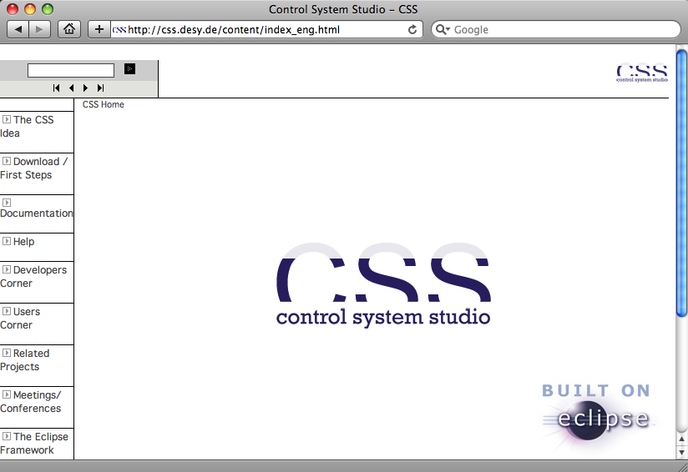
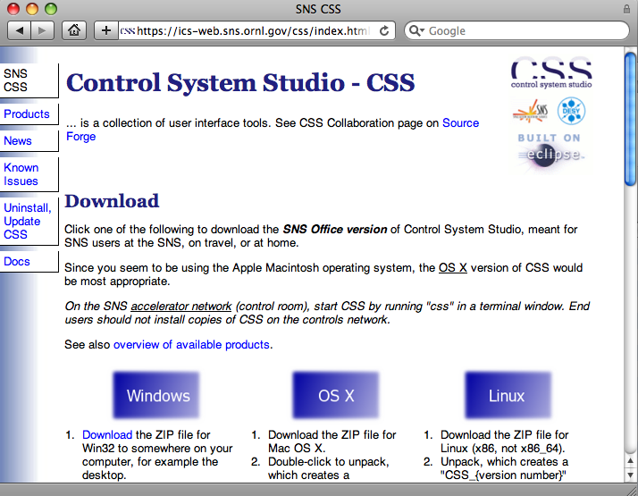
Where’s the Stuff??
css.desy.de
  DESY Products
  Docs
  CVS
  Wiki
  CodeBeamer
ics-web.sns.ornl.gov/css
  SNS Products
  Docs

Slide 4
Worked OK for DESY & SNS, but…
DESY Web page, Wiki, Code beamer, …
  Difficult to access outside of DESY
CVS @ DESY
  No anonymous read access
CVS in general
  Not distributed
  No change set support

Slide 5
Why the Repository matters
org.csstudio.platform currently includes
  DAL
  User/Authentication/Authorization
  EPICS DB File parser
  …
These CSS tools don’t need it:
  Archive Engine, Alarm Server, Annunciator, Interconnection Server, JMS-to-RDB logger, …
As the collaboration grows, we need to modularize better.
Even “simple” changes (move a file, refactor code) affect many files in multiple plug-ins.
Bad with CVS, fine with change-set support.

Slide 6
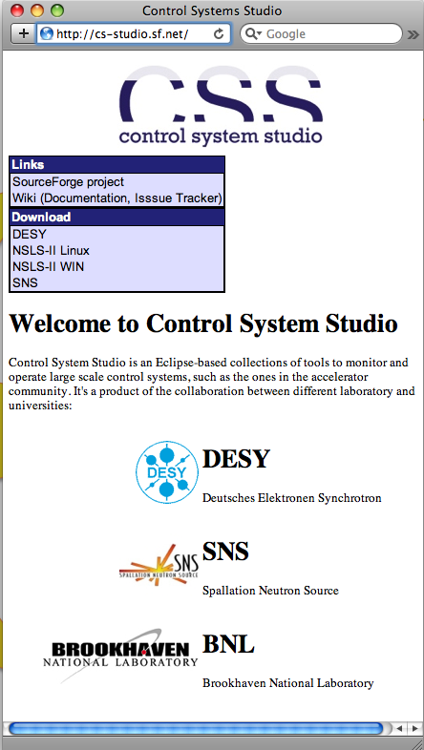

The Plan:
Source Forge

Slide 7
Why Source Forge?
“I personally prefer Google Code”
“But EPICS uses Launchpad”
“Have you looked at BitBucket?”
Matthias had already applied for cs-studio.sf.net
Collaborators at BNL were most familiar with SF

Slide 8
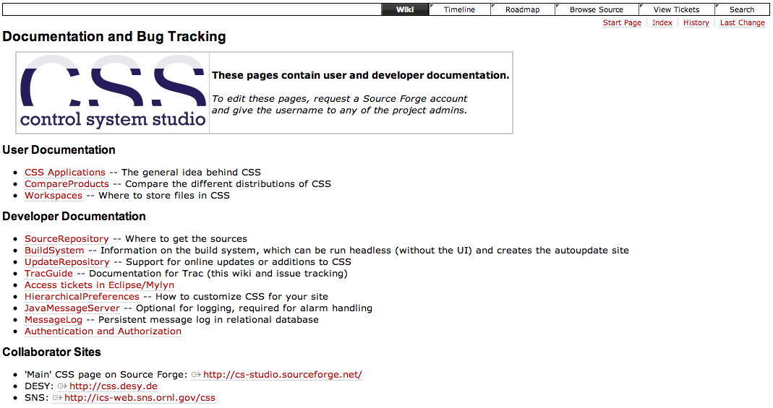
SF Wiki
A shared location for our how-to-notes

Slide 9
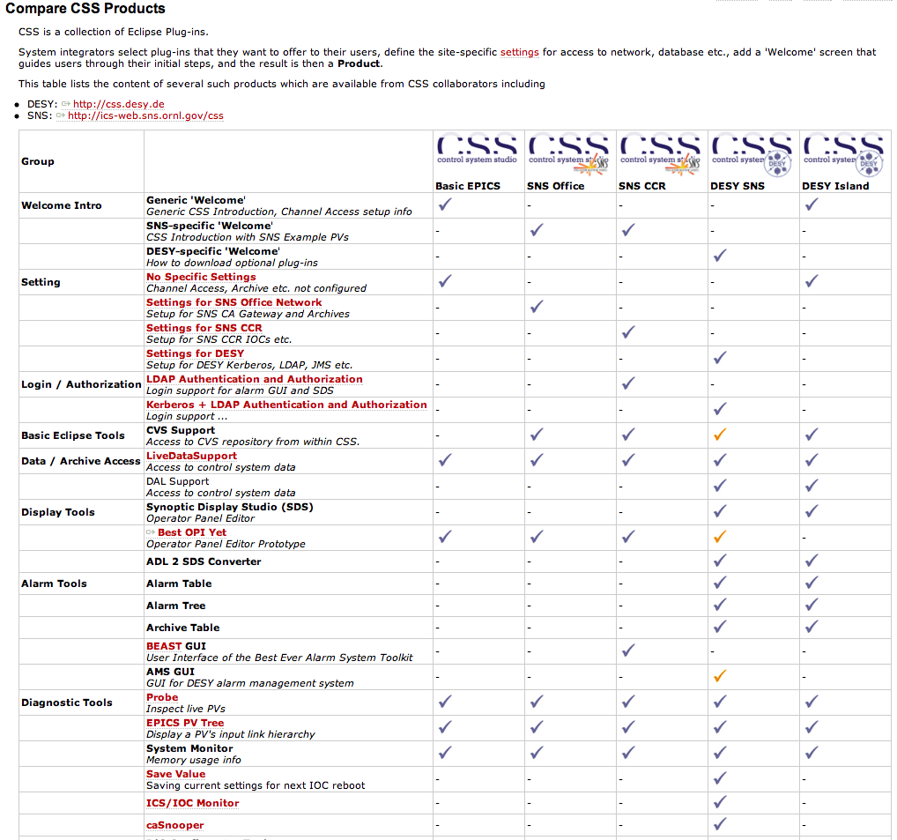
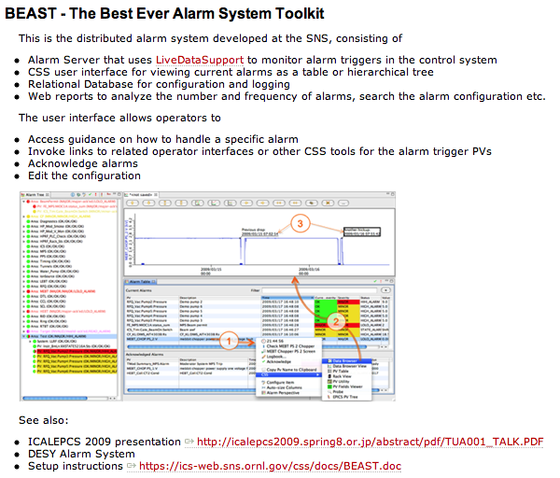
Plugin Parade
CSS = Plugins that you combine into a Product for your site
What’s available?Who’s using it?

Slide 10
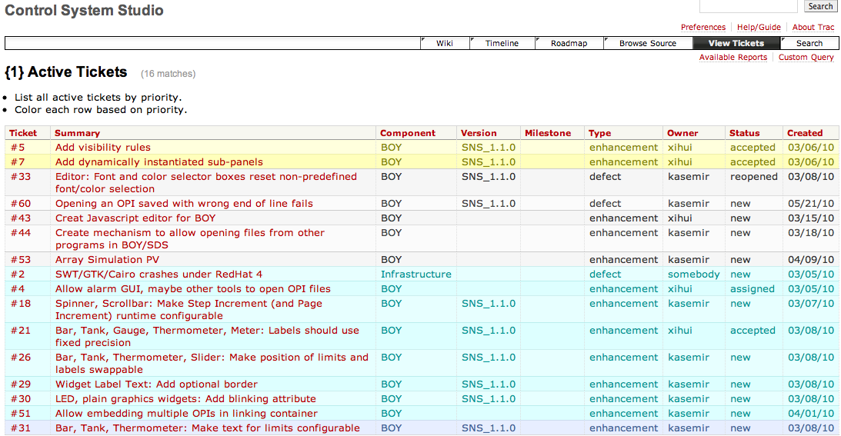
Issue Tracker
Used for BOY development

Slide 11

Summary
http://cs-studio.sf.net
Wiki
Tracker
Repository
  “Mercurial: Good Eclipse support, distributed, change-sets”
  “But our local CVS repo works fine for us”
  “What about GIT? Bazaar? Subversion?”
  DARCS: Haskell, Recursive Acronym. Need I say more?
  Lacking a Benevolent Dictator
Mercurial!

